Slide 1
Machine Learning

Slide 2
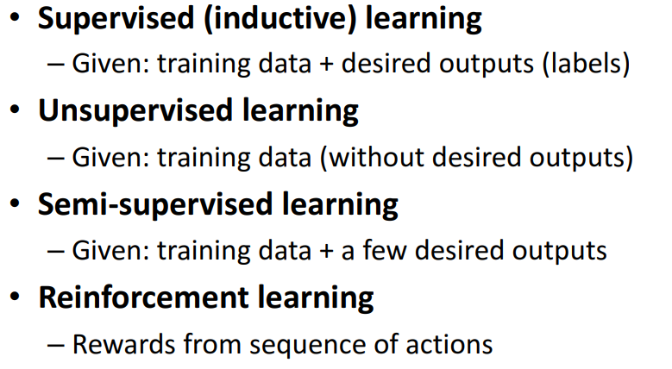
Types of Learning

Slide 3
Steps of Machine Learning
Step1: Data Acquisition
Step2: Prepare the input data
Step3: Analyze the input data(EDA)
Step4: Data Modeling
Step5: Train the algorithm
Step6: Test the algorithm
Step7: Hypertune the model
Step8: Deployment

Slide 4
Resources: Datasets
UCI Repository: http://www.ics.uci.edu/~mlearn/MLRepository.html
UCI KDD Archive: http://kdd.ics.uci.edu/summary.data.application.html
Statlib: http://lib.stat.cmu.edu/
Delve: http://www.cs.utoronto.ca/~delve/
Inbuilt Dataset: pandas, sklearn, keras, huggingface

Slide 5
Requirement of Data Acquisition
Working with csv, json, SQL(Pandas, numpy, sql)
Fetch data from API (beautifulsoup)
Web scraping (Scrapy)

Slide 6
Prepare the Dataset
Types of Data:
Numerical
Categorical
Ordinal

Slide 7
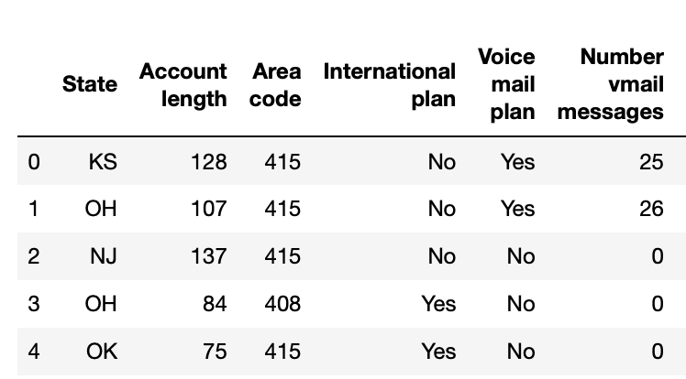
Prepare the Dataset
Types of Data:
Numerical
Categorical
Ordinal
Churning Rate
High
High
Medium
Low
Low

Slide 8





Encoding
Types of Encoding:
Label Encoding (Output)
OneHotEncoding (Input)
Ordinal Encoding (Input, Output)
Churning Rate
High
High
Medium
Low
Low

Slide 9
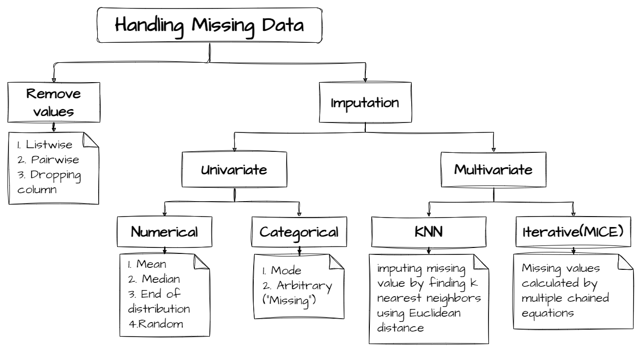



Missing Value Handling
Mixed Value Handing
Cabin | Class | Seat
C5 | C | 5
B19 | B | 19
Date | Day | Month | Year
02/07/1995 | 02 | 07 | 1995
03/03/2024 | 03 | 03 | 2024

Slide 10
Data Analysis
Shape, Size, Column data type, missing value, duplicate value, column name
Univariate Analysis
Histogram
Distplot (Histogram +
Kernel Density Estimation)
Boxplot
Violine plot
Bivariate or Multivariate Analysis
Scatter plot (num-num)
Bar plot (num-cat)
Box plot (num-cat)
Dist plot (num-cat)
Pair plot (num-num)
Heatmap (cat-cat)
Cluster map (cat-cat)
Line plot (num-num)
Pivot plot (num-cat)

Slide 11
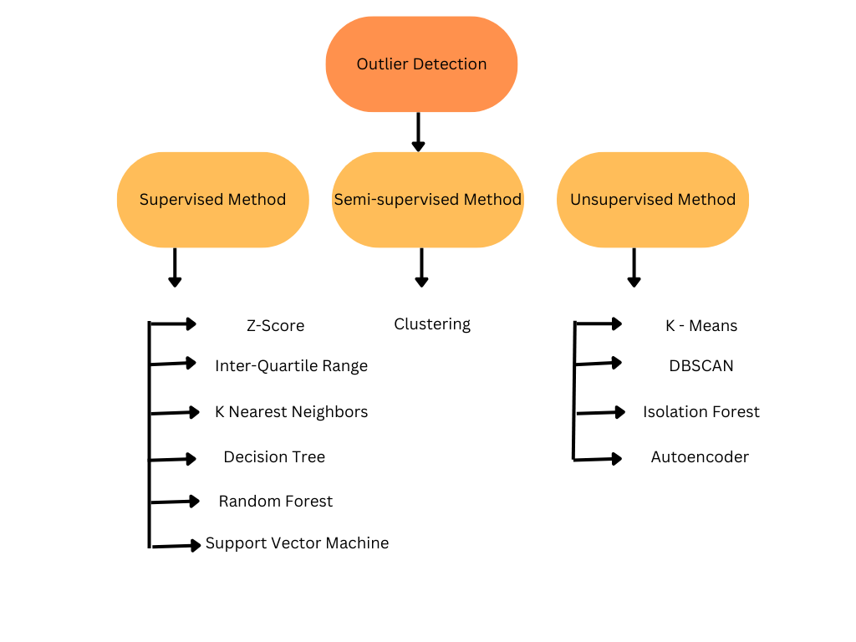
Outliers Detection Techniques

Slide 12
Transformation Techniques
Column Transformation
Pipelines
Function Transformation
Power Transformation
Standardization
Normalization
Binning & Binarization
Descretization

Slide 13
Data Modeling
Train Test split
Train size
Test size
Validation data
Model fitting

Slide 14
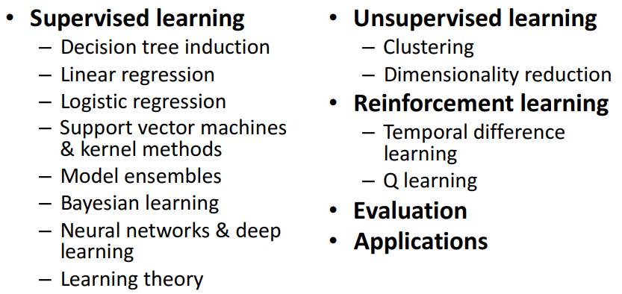
Machine Learning Algorithm

Slide 15
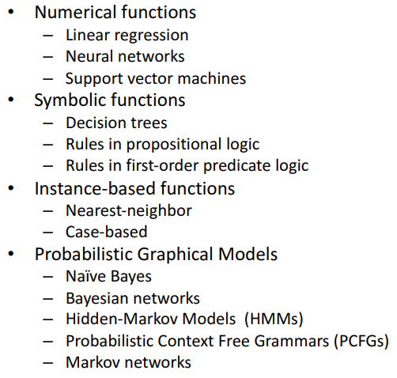
Various Function Representations

Slide 16
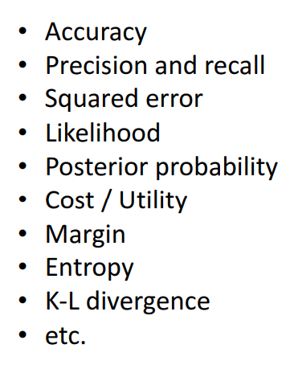
Evaluation

Slide 17
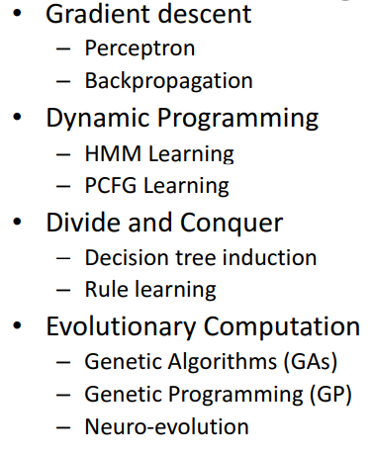
Various Search/Optimization Algorithms

